Slide 1
Woojin
Inter-M

Slide 2

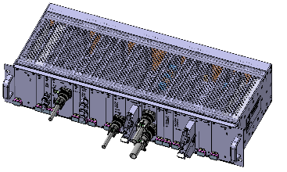
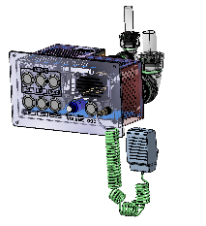
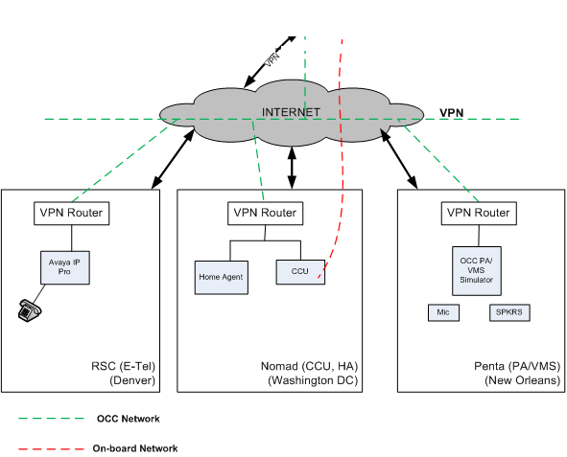
CRA
DPO
PEI
Woojin
VPN Server

